Slide 1

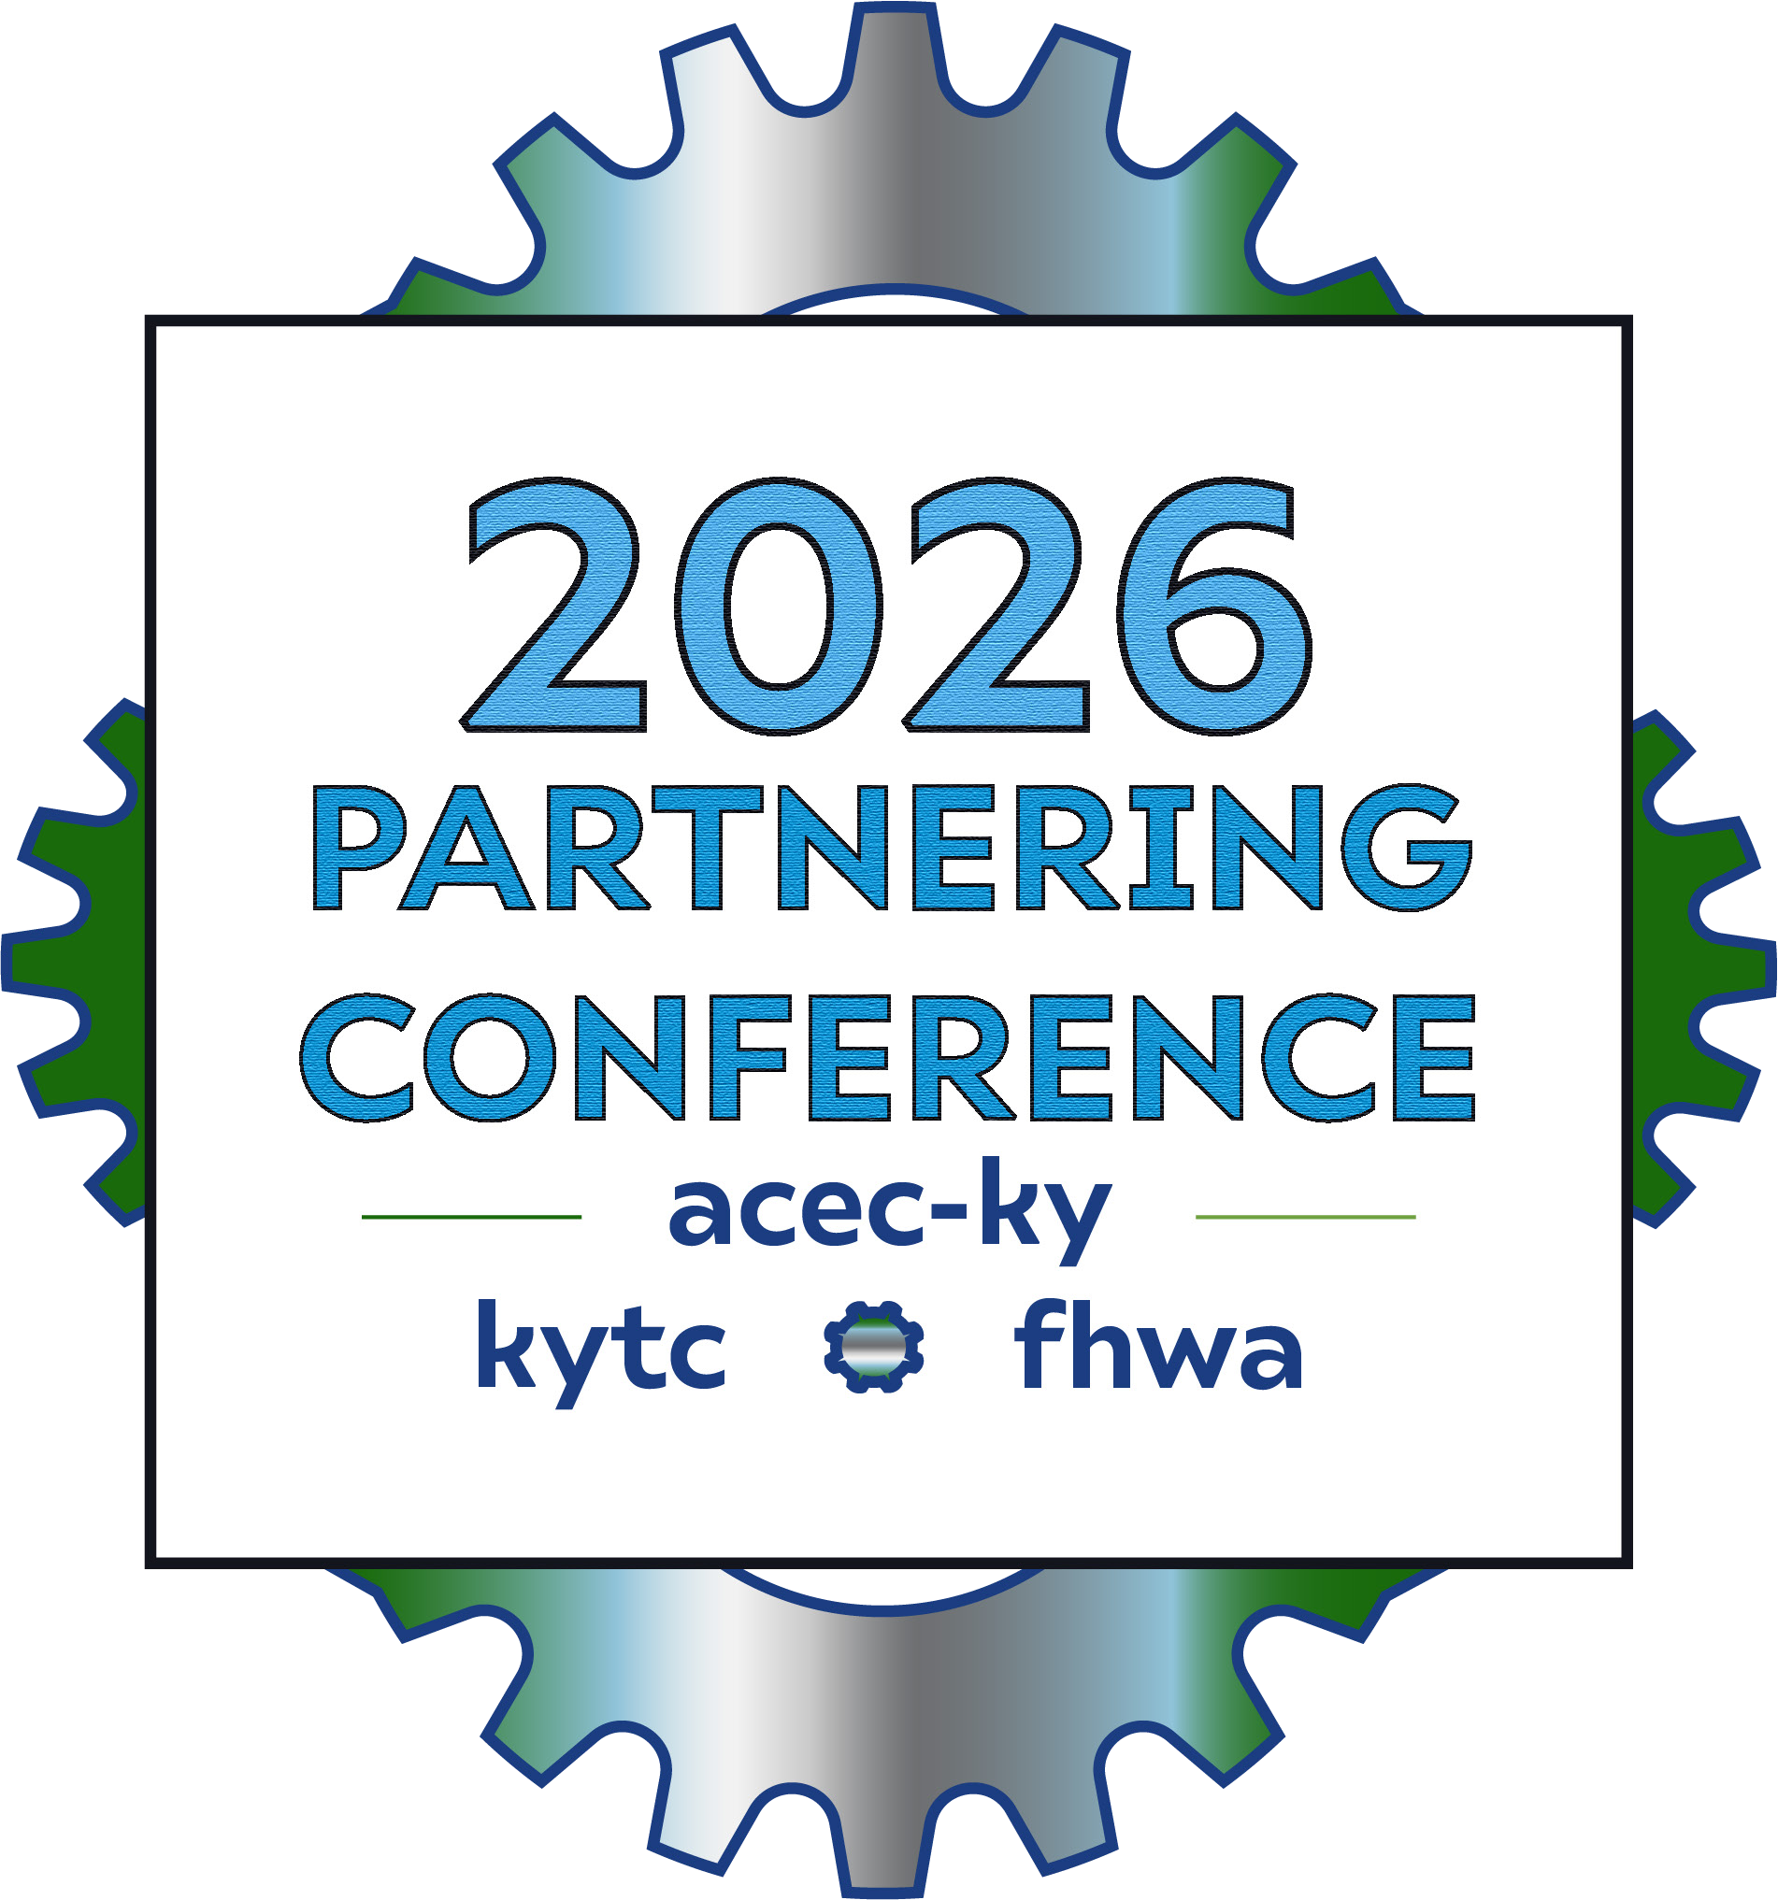
Getting in Front of the Issue with Early Utility Accommodation
Emily Eising, District 6 Utility Supervisor
Jennifer McCleve, Central Office Utilities Branch Manager

Slide 2
What is Early Utility Accommodation (EUA)?
EUA Process
What EUA Can Do
IRL Project Example

Slide 3


What is Early Utility Accommodation (EUA)?
EUA is:
The work may be state funded and federally reimbursed later, provided a series of conditions are met.
A set of utility focused tasks that can be performed in advance of environmental approvals.

Slide 4


EUA Scope:
Utility Coordination Services
Specialty Material Acquisition
Utility Relocation Construction
Utility Design Services
Note: Early utility relocation construction requires independent environmental reviews to use.

Slide 5

Minimum Requirements
Project Requirements
Title 23 Eligible Transportation Project
Included in
Kentucky’s Statewide Transportation Improvement Program (STIP) and/or
Regional/Local’s Transportation Improvement Program (TIP)

Slide 6
Minimum Requirements
EUA Scope MUST be:
Reimbursable under law and regulation
Required for the transportation project
Identified through an agreement
Comply with laws, regulations, & policies
Have an approved environmental evaluation (relocation construction only)
EUA CANNOT:
Cause significant adverse environmental impacts
Influence the transportation project's environmental review

Slide 7
What EUA Can Do:
Utility Design Services
Utility Coordination Services
Specialty Material Acquisition
Utility Relocation Construction

Slide 8
Utility Design Services
Estimates
Utility Coordination Services
Conflict and Resolution Planning
Design Agreements
Consultant Approvals
Oversight
Utility Design Tasks
Relocation Agreements
Replacement Easement Acquisition
Specialized Material Acquisition
Estimate
Materials
Contracting
Utility Relocation Construction
Utility Coordination Tasks
Planning
Construction
NEPA Approval for Utility Work
Inspection

Slide 9
Utility Design Services
Conditions of Use
Early Identification
Acquisition of specific parcels of ROW (in rare cases)
Early utility coordination benefits a project that has a firm deadline to construct, and the utility impacts are either unknown or suspected to be avoidable.

Slide 10
Specialty Materials Acquisition
Conditions of Use
Limited in supply
Likely cost increase of 20%+ if not early
Likely long lead time to acquire (6 mo+)
High demand material that may become unavailable or
Needs extensive engineering or specially designed elements

Slide 11


Specialty Materials Acquisition
Restocking Fees
• Any restocking fees or penalties must be addressed in the agreement between the Cabinet and the utility company.
Delivery
Damages
• Liability of damages and material inspection criteria must be clear.
Storage
• Delivered EU materials may be stored by the utility company (preferred) or by the Cabinet.
• Materials are preferred to be delivered directly on the project site in tandem with the construction work.
• If not viable, material storage location and standards should be in the agreement between the Cabinet and the utility company.
• If the Cabinet stores materials, the utility company shall inspect the material upon delivery and once again when on the project site.
•Cabinet liability for damages shall be minimized when possible.

Slide 12
Utility Relocation Construction
Conditions of Use
Utility relocation is unavoidable
Likely a CE
Minimal or no ROW needs
Project schedule needs early relocation
Environmental review is completed for the relocation
No significant environmental impacts finding
Reocation alignment is certain

Slide 13
Early Materials and Utility Relocation Construction
Risk
Uses state EUA funds to perform work
Costs may be deemed ineligible for FHWA reimbursement

Slide 14
EUA Process
FHWA Reimbursement
Plan EUA
Request EUA Approval
Execute EUA Scope
Identify EUA scope.
Confirm compliance with requirements.
Confirm project and utility impacts.
Consider environmental impacts.
Estimate budget.
Ensure ability to comply with terms and conditions of EUA.
Ensure compliance with policies.
Validate no interference with elements of project.
Complete utility design.
Coordinate interaction with project.
Ensure utility materials are acquired.
Monitor utility relocation construction.
Make sure utility environmental approvals are complete.
Confirm EUA scope completion.
Verify compliance with EUA terms.
Confirm project construction authorization.

Slide 15
Determine during planning or phase 1 design that the project may benefit from any EUA scope items:
Utility Design
Utility Coordination
Utility Relocation
Utility Materials
Utility Coordinator shall ensure the involved utility company is willing
Team confirms the project and utility impacts proposed for EU are in line with the EA Accommodation Criteria discussed in this document, including that the utilities are unavoidable. (Consider SUE to validate the impact is unavoidable)
Team confirms the environmental impacts for proposed EU are minimal. We must carefully consider the costs and impacts from a second NEPA
Verify that the work can fit into the existing D phase budget, request additional D funds, or plan to secure state funds to execute the work
Utility Coordinator completes the Form
Validate no interferences with elements of the project, including NEPA.
Utility Coordinator submits the form and supporting documentation internally
Approved EU Request sent to the FHWA Kentucky Division Office for concurrence
If the EU scope used State EU Funds and the KYTC project is awarded:
Verify the EU work is complete;
Verify the EU work performed did not impact the KYTC project NEPA; and
Notify accounts and program management that the EU Phase may be reimbursed by FHWA.
Before costs incurred are approved for Federal participation:
FHWA must receive the NEPA utility evaluation and necessary documentation;
Transportation project must be authorized for construction; and
Detailed and itemized cost documentation must be provided.
Additional EU funds requests:
DUS requesting shall notify that this request is related to an existing EU phase authorized. These additional funds may be federal or may not.
Additional requests must be based upon actual expenditures.
Team estimates the budget necessary to execute the scope.
Plan to secure state funds from program management to execute materials or construction
Ensure ability to comply with terms and conditions
Ensure compliance with policies
If State EU Funds are needed, send to the Division of Program Management for acceptance and processing
Begin the EU scope

Slide 16
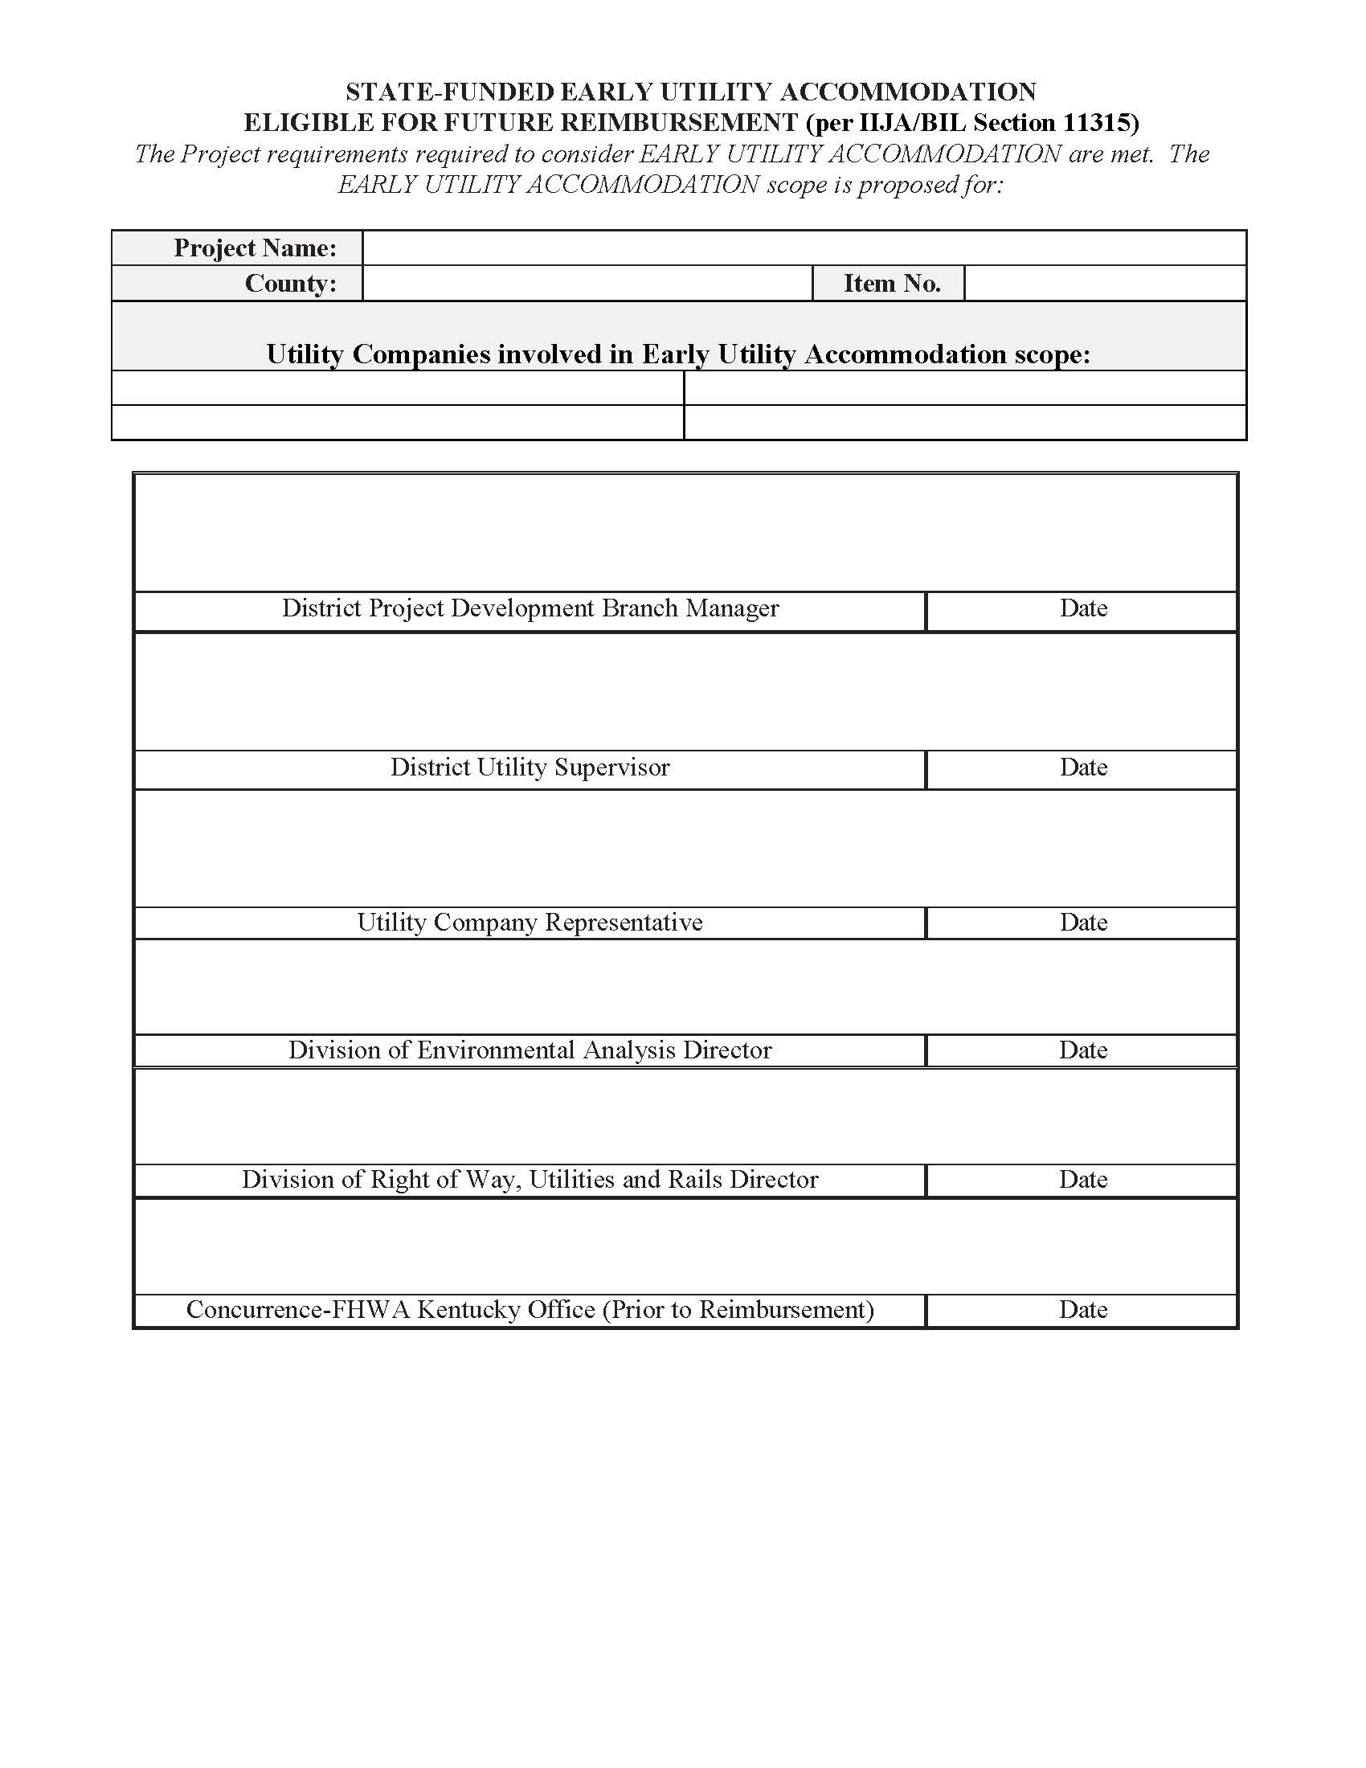
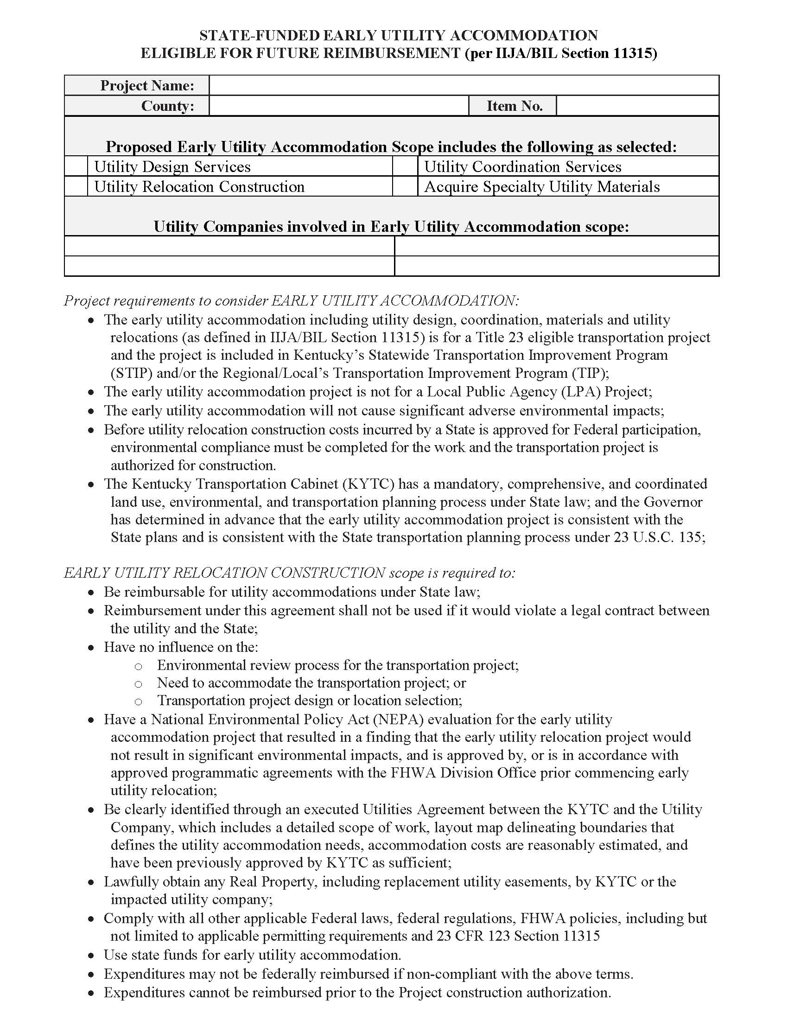

Slide 17
Projects Viable for EUA
Not all projects should use EUA.
Cabinet priority
Firm deadline to construct
Firm/set alignment
New corridor
No critical environmental features
Unavoidable utility impacts
Utility relocations require more time to design or construct
Utility materials require more time to secure, engineer, or fabricate
Impacts a large utility company
Impacts large scale utility facilities (i.e., buildings or pump stations)
Utility relocations located within existing ROW

Slide 18

IRL Project Example: 6-1087
Project Situation
Project required relocation/accommodation of 6 electric transmission poles.
5 poles would be a KYTC project cost; 1 pole would be Duke Energy’s cost.
Estimated pole cost: $200,000 each
Potential KYTC cost: $1.0 million
Schedule Considerations
Duke Energy indicated a 12 to 18-month lead time for the transmission poles.
The project also required railroad (RR) coordination, creating an additional schedule dependency.
With both utility procurement and RR coordination affecting the critical path, the project team considered purchasing the poles early to minimize the potential for utility-related delays.

Slide 19
Specialty Material Acquisition
Allowed KYTC to identify a significant utility procurement issue well before construction.
Reduced the risk that a long-lead utility delay a project already dependent of RR coordination.
Why EUA Mattered
Provided an opportunity to manage a potential $1.0 million KYTC expenditure proactively.

Slide 20
Key Takeaways
Large utility involvement – required significant planning & lead time.
Unavoidable impacts – impacts to electric transmission poles could not be avoided.
Extensive engineering – electric transmission poles require substantial design & engineering.
Long-lead materials – poles had an estimate 12 to 18-month procurement lead time.
Multiple coordination requirements – additional schedule risk created because project involved RR.

Slide 21
IRL Project: Key Takeaways
Enhance Coordination & Project Flexibility
Identify Utility Impacts Early
Coordinate Early with Utility Owners
Manage Project Risk
Understand conflicts and accommodation needs during project development, not during construction.
Early communication provides time to address complex design, engineering, and relocation requirements.
Early action can reduce the risk of utility coordination becoming a critical-path issue.
Utility work often intersects with railroad, right-of-way, environmental, and construction activities.
Transmission facilities and other specialized utility components may require extensive engineering and extended procurement periods.
Early decisions provide greater opportunity to understand, plan for, and control utility-related costs.
Early accommodation gives KYTC more options to address unavoidable impacts before they become construction problems.
Early utility accommodation is an investment in project certainty—reducing risk, protecting schedules, and improving KYTC’s ability to deliver projects successfully.

Slide 22
Questions?
What is Early Utility Accommodation (EUA)?
What EUA Can Do
EUA Process
IRL Project Example

